Slide 1
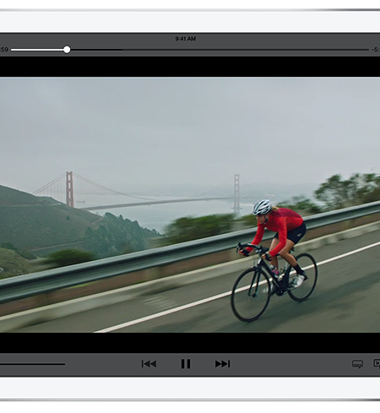

HTTP Live Stream HLS
https://developer.apple.com/streaming/

Slide 2
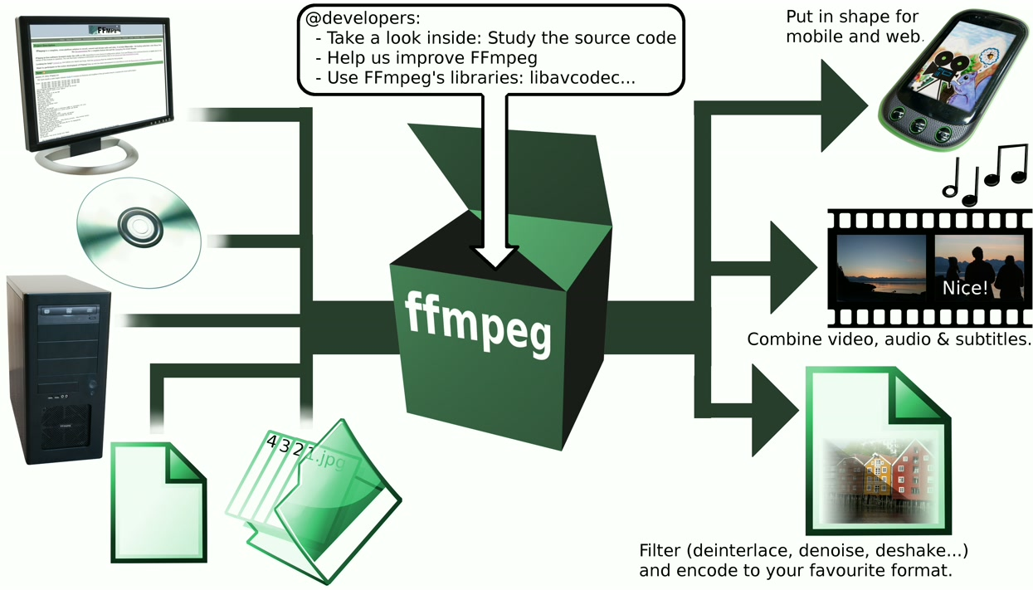

FFMPEG [ToDo: Explicar o papel dele]

Slide 3

Video JS + Plugin HLS
http://videojs.com/
http://videojs.github.io/videojs-contrib-hls/

Slide 4
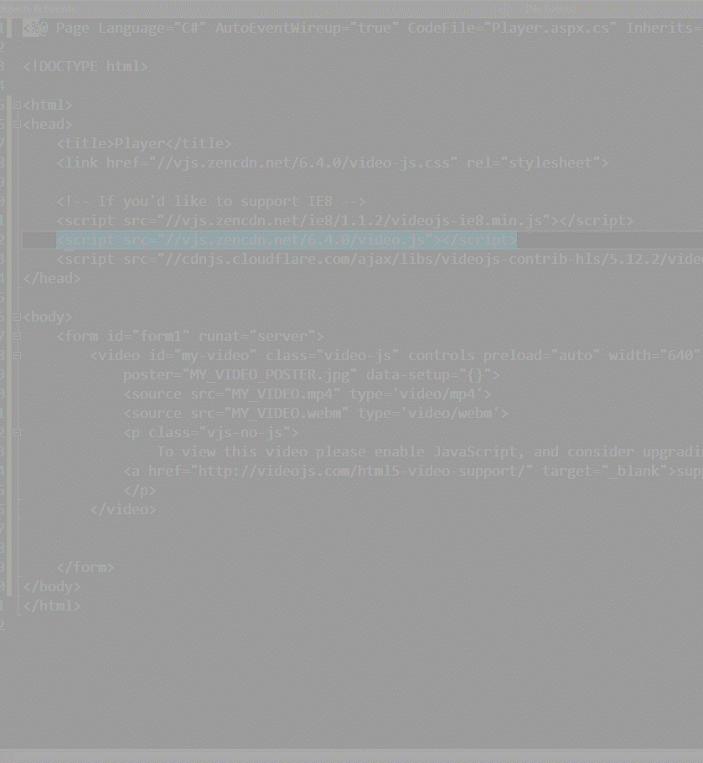
ESTAMOS USANDO CDN de TERCEIROS
Apenas para fim teste.
Os arquivos devem fazer parte do seu projeto.
CSS
//vjs.zencdn.net/6.4.0/video-js.css
JS
//vjs.zencdn.net/ie8/1.1.2/videojs-ie8.min.js (se quiser IE8)
//vjs.zencdn.net/6.4.0/video.js
//cdnjs.cloudflare.com/ajax/libs/videojs-contrib-hls/5.12.2/videojs-contrib-hls.js

Slide 5
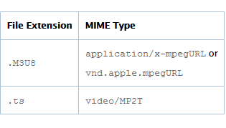
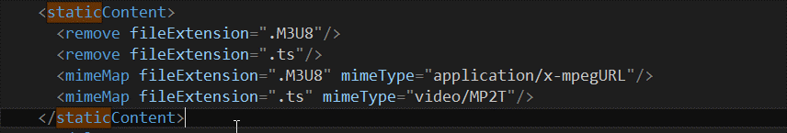
Genericamente:
MIMES TYPES
Asp.Net:
https://developer.apple.com/library/content/documentation/NetworkingInternet/Conceptual/StreamingMediaGuide/DeployingHTTPLiveStreaming/DeployingHTTPLiveStreaming.html

Slide 6

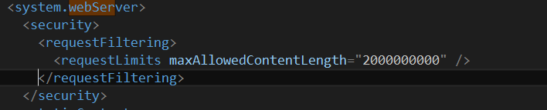
ffmpeg_path

Slide 7
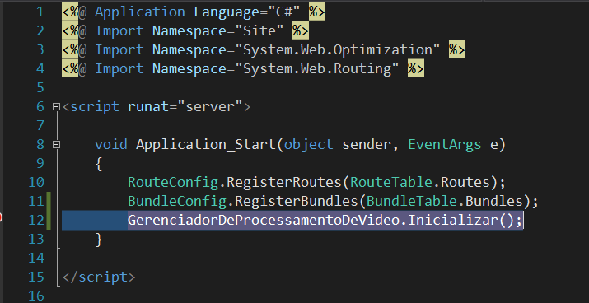
Application_Start (Global.asax | Global.asax.cs)

Slide 8
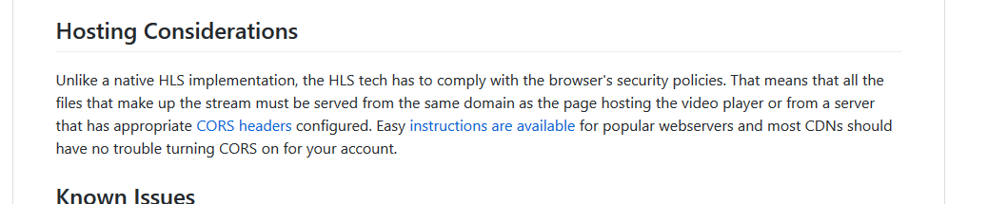
Considerações sobre uso na CDN
https://github.com/videojs/videojs-contrib-hls#presence-stats

